Slide 1


Autonomous Toolkit to Forecast Customer Churn
Group Members
Sumaira Javed Malik
Mehwish Farooq Ahmed
Supervisor
Dr. Zaffar Ahmed Shaikh
Co - Supervisor
Ma’am Samreen Ahmed

Slide 2
OUTLINES
Problem
Solution
Minimum viable product
Competitive advantage
Monetization model
Team

Slide 3
Problems
One of the key aspirations of any telecommunication
company is to maintain a loyal customer base.
Customer churn is one of the major issue, that the telecom
industry is facing today.
Customer churn can be defined as the switching
of a customer from one service provider to another.

Slide 4
Cont…
Mobile carrier’s current focus on customer retention strategies.
Churn prediction and prevention becomes a crucial Business Analytic Application.
Telecom companies have used two approaches.
targeted and untargeted approach.
- The targeted approach relies on identifying customers who
are likely to churn.
- The untargeted approach relies on superior product
and mass advertising to increase brand loyalty.

Slide 5
Solution
Dataset from Big ML site
Pre-processing of dataset
It would run different algorithm to analyze the dataset
(Random forest, Decision tree and Gradient Boosting
& AdaBoost algorithm)
Build a predictive model
Design a toolkit
The result of the performances of different models would show at the end on the dashboard and charts.

Slide 6
Tools for the Project
The language used for the project is Python using
Jupyter Notebook.
The data will be analyzed by using the descriptive stats in which the libraries of a Python has been used.
- Pandas
- Numpy
- Matplot libraries
- Scikit-Learn
- Stats Models

Slide 7
Methodology
We are trying to automate the working of a Data scientist.
Restate the aims.
I. An autonomous data science Tool kit.
II. Will run different algorithms to analyze the data.
III. Select the best possible solution(algorithm) per given dataset.

Slide 8
Methodology(cont..)
Telecommunication companies are using data mining techniques to identify customers that are likely to churn.
CRISP-DM is the most popular methodology for Analytics, Data Mining and Data Science projects.

Slide 9
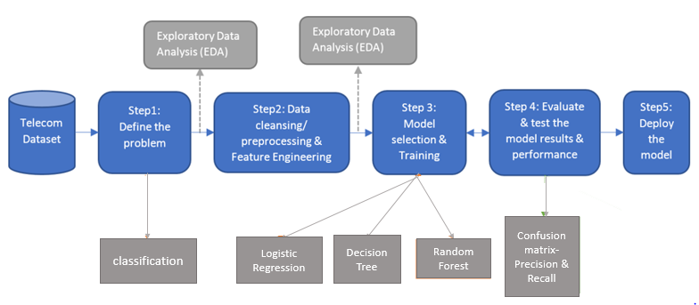
CRISP MODEL

Slide 10
Abstract User Interface
The application would take the dataset as an input in csv format. After the input of the Data, the summary of the data shall be shown graphically.
The data would be analyzed and summary of the data shall be shown using the Descriptive Statistics technique.
The graphs of performance of different models shall be shown when the model is learned and applied.

Slide 11
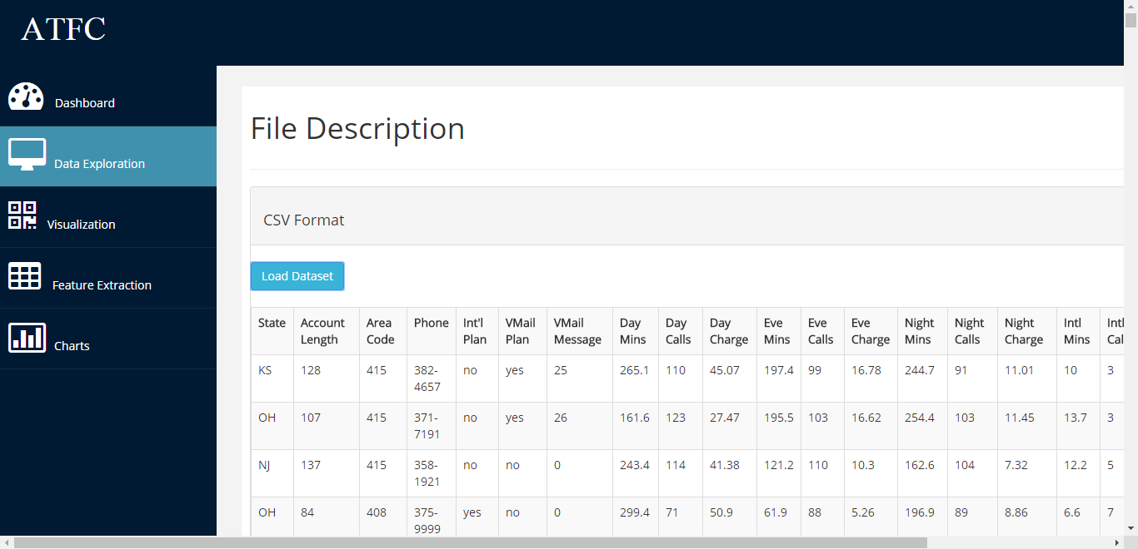
Minimum Viable product

Slide 12
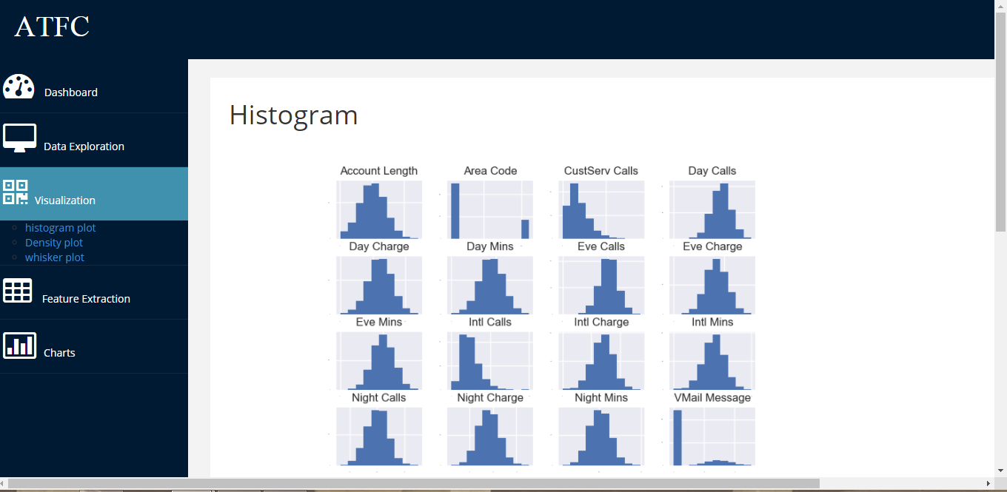

Slide 13
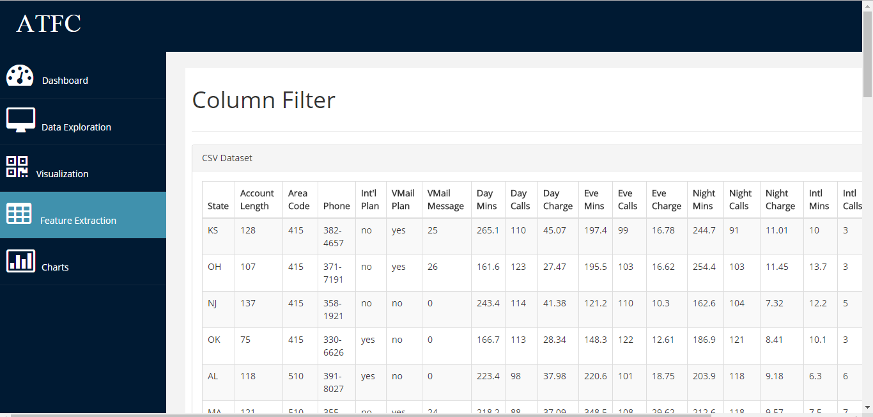

Slide 14
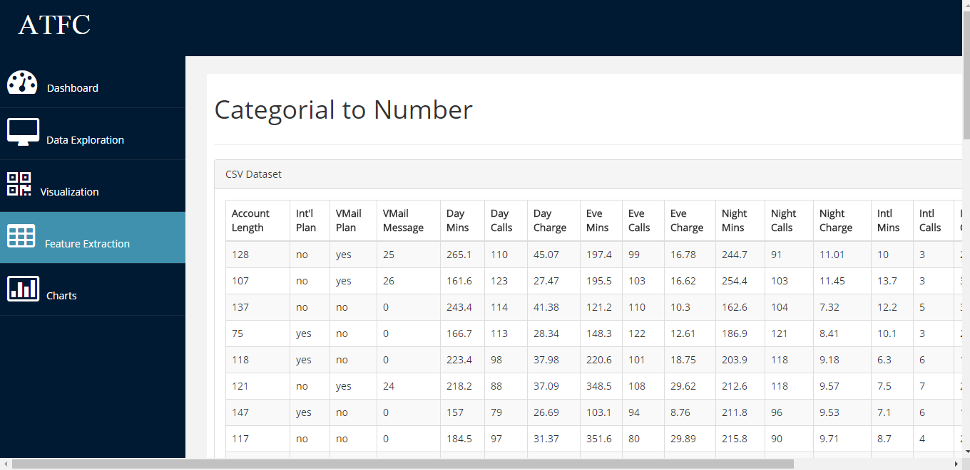

Slide 15
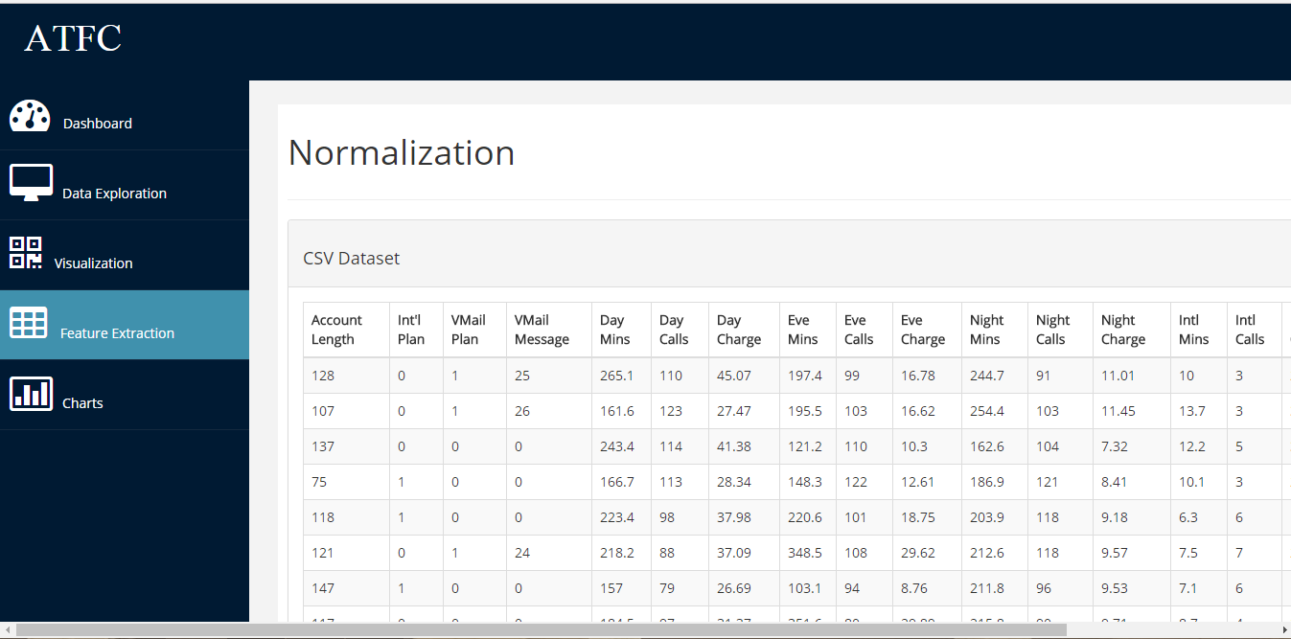

Slide 16
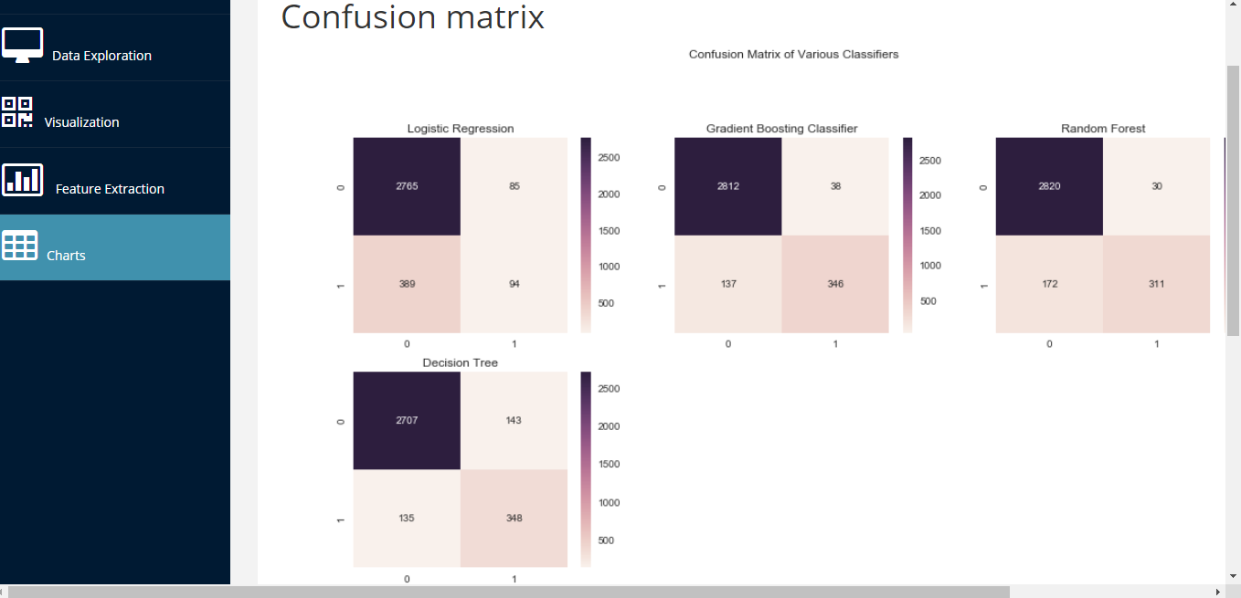

Slide 17
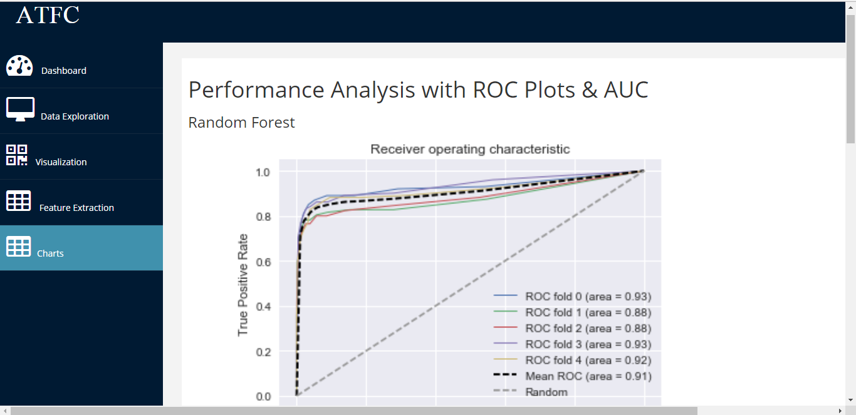

Slide 18
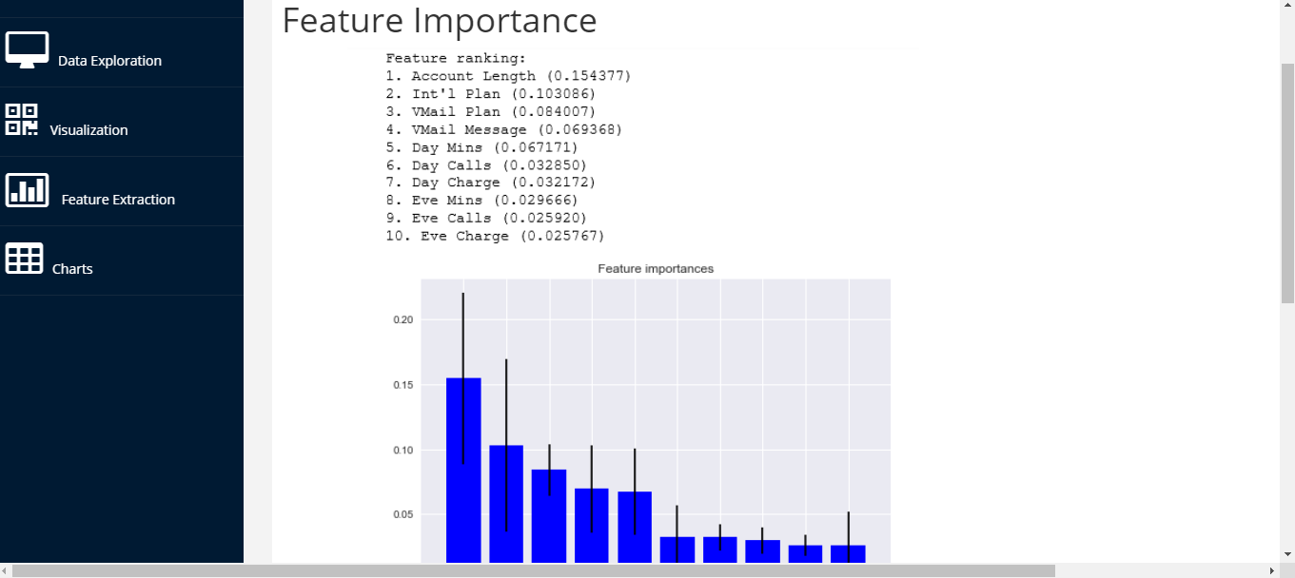

Slide 19
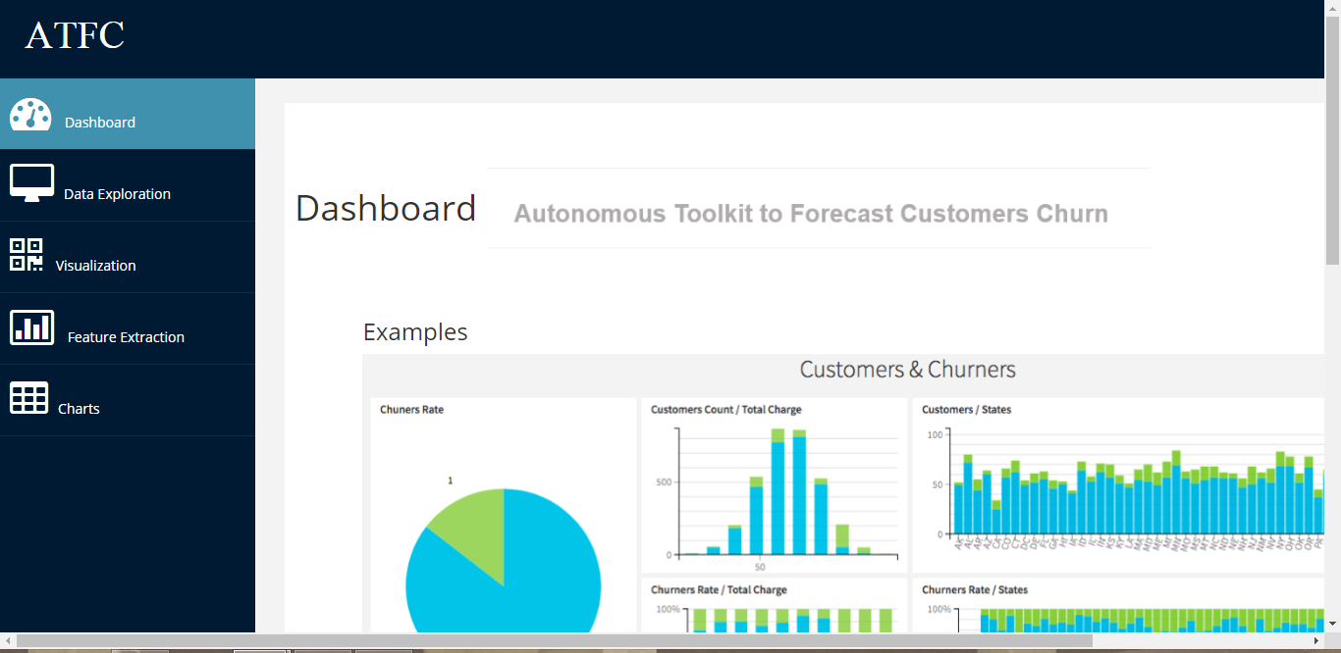

Slide 20
Competitive advantage
The problem with the data scientists is that either they aren’t available or are too much expensive to afford for some companies.
The main goal of this project is to reduce the effort of the data scientists who have to spend too much time on Data pre-processing and identifying the best predictive model.

Slide 21
Cont…
There’s a need of a tool which can provide an abstract interface to the business manager.
Business managers to make appropriate decision to retain them by fringe offerings and other incentives.

Slide 22
Monetization model
This model can not fit for every kind of dataset .
Different models can be built depend on dataset
and its variables .
If we do these kinds of predictions and analysis then companies will surely give us high salary according that.

Slide 23
Team
Sumaira Javed Malik (PROGRAMMER)
Mehwish Farooq Ahmed ( WEB DESIGNER)

